Slide 1
Introduction to Python
Lauchlan Toal
lauchlan@dal.ca

Slide 2
Why Use Python
Concise
Well-supported
Flexible indexing
No compilation
Easy syntax

Slide 3
Python Basics
Variables: Inferred types, just write the name
a = 5
name = "Sam Smith"
Functions: Start with def, then function name, then parameters
def doubleInt(x):
return x*2
b = doubleInt(a)
Scope: Determined by indentation level

Slide 4
Python Basics
For Loops: Implemented as foreach loops, iterating through a collection
for i in range(10):
print(i)
While Loops: Similar to other languages
i = 0
while i < 10:
print(i)
i += 1
Booleans: True, False, and/or instead of &&/||

Slide 5
Python Basics
Arrays: Arrays are really lists, with dynamic size and mixed types
myList = [1,2,3,4]
myList += "a" #[1,2,3,4,'a']
String/Array Indexing: Python is excellent at array and string indexing
name = "Sam Smith"
name[0] #S
name[0:3] #Sam
name[:3] #Sam
name[3:] # Smith
Comments: Single line with #comment, multiline with '''comment'''

Slide 6
Python Versions: 2 or 3?
Python 2 Advantages
Python 3 Advantages
What Dr. Brodsky uses for solutions (unless he’s changed – the scanner is compatible with both so it’s possible he uses Python 3 now).
Invoked simply with “python myfile.py” in Bluenose.
Installed by default on most Macs.
Older, so possibly easier to find used books on the subject.
Much stricter, aiding in debugging. For instance, in Python 3, 5 > "hi" will give a TypeError, as there’s no default way to compare an integer and a string. In Python 2, it will evaluate to False, because it casts it to "int" > "str" and compares the strings lexicographically.
Higher quality resources available.
More help available from peers and online groups as more people use it now.
More valuable to your career going forward.

Slide 7
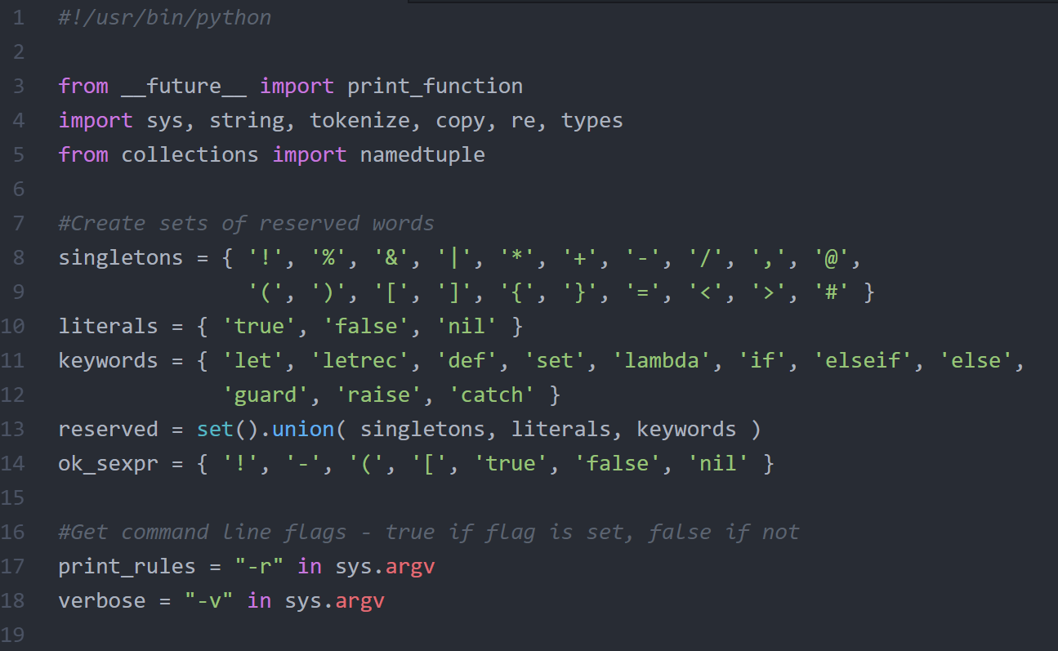
Python Scanner Example
Import necessary libraries.
Sets of important tokens will be used to simplify checking if a token is part of the language or a user defined value.
Sets cannot contain any duplicates.
The union function combines sets, as per a union of sets in mathematics.
Possible execution flags are identified, though they aren’t used in this program. One couple possibly use them for debugging.

Slide 8
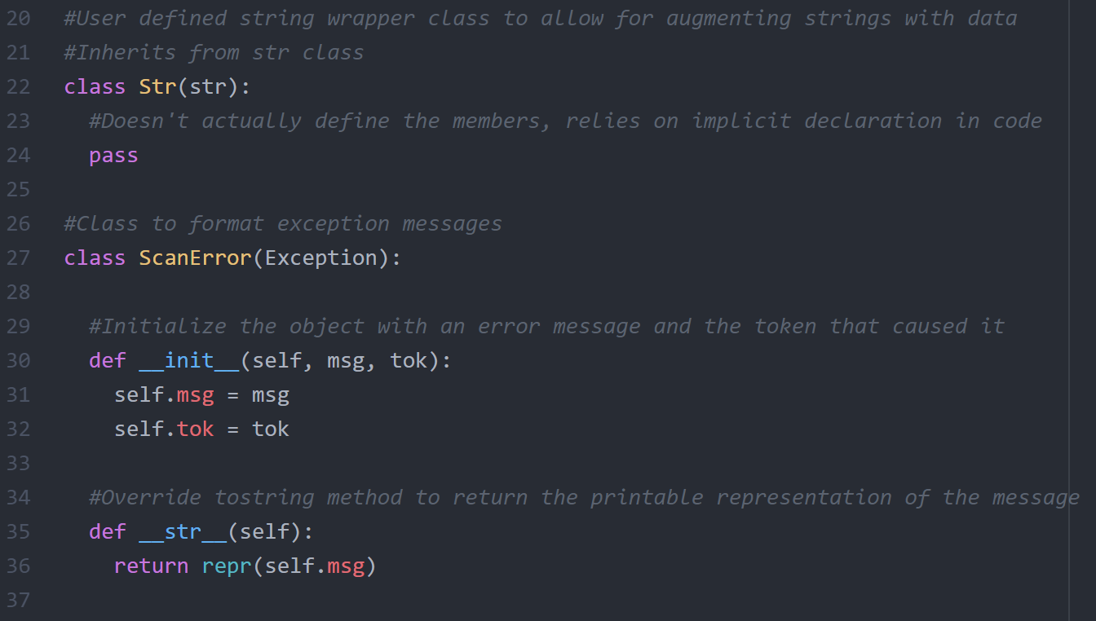
Python Scanner Example
The Str class inherits from the str class, serving as a wrapper that allows for augmenting the class.
The ScanError class inherits from the Exception class, storing a message and token upon creation and returning a printable representation of the message when printed.

Slide 9
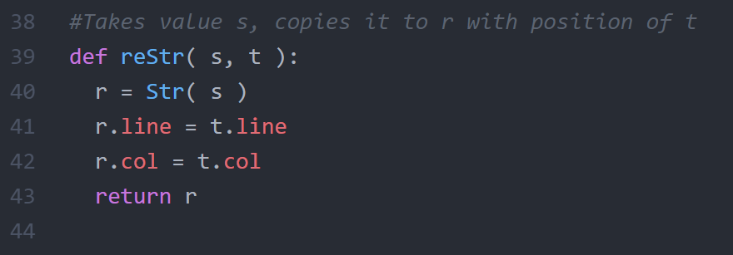
Python Scanner Example
reStr function returns a Str object with the value from s and the line and col (column) positions from t.
Note that the Str class is not listed as having line and col properties – these are added implicitly later in the code, making it difficult to understand and debug. These attributes should be explicitly listed in the class definition instead.
Also note the lack of comments and unclear names – ensure that the purpose of every function is commented and both functions and variables have meaningful names.

Slide 10
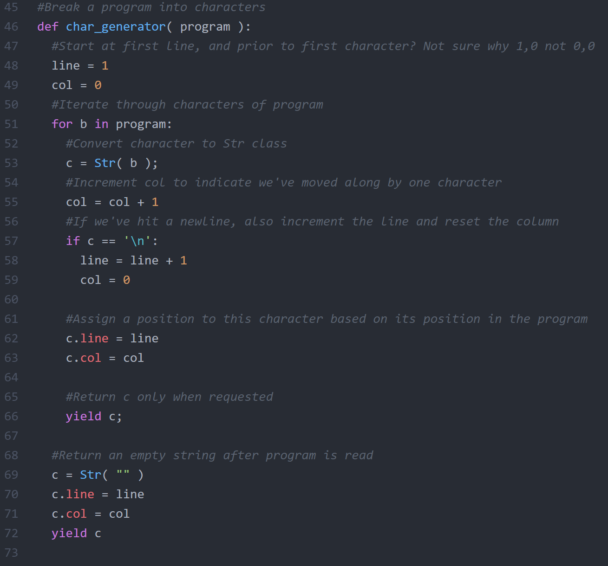
Python Scanner Example
This generators takes an iterable like a string, and yields a character each time it’s called.
Each character is cast to an Str object and given a line and column value, reflecting its position in the program.
When all characters have been read, the generator yields an empty string.
Generators are just functions that keep track of some internal state and yield a value each time it’s called, dependent on the internal state. In this case, it yields the next character each time it’s called. They are identical to functions except for using “yield” instead of “return”.

Slide 11
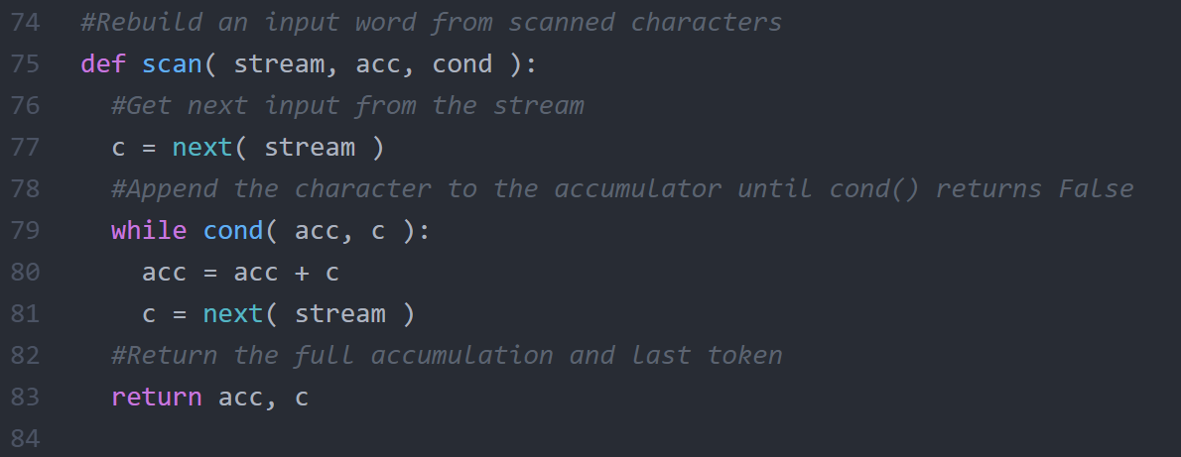
Python Scanner Example
This function takes in a stream, which in this case is the generator we just saw. It also takes an accumulator variable which accumulates characters into a token, and a cond function which determines when the token’s end is reached.
The stream is iterated through, appending characters from the stream to the accumulator until a character is reached that causes the condition function to return False.
The accumulator (token) and the last character read are returned to the caller.

Slide 12
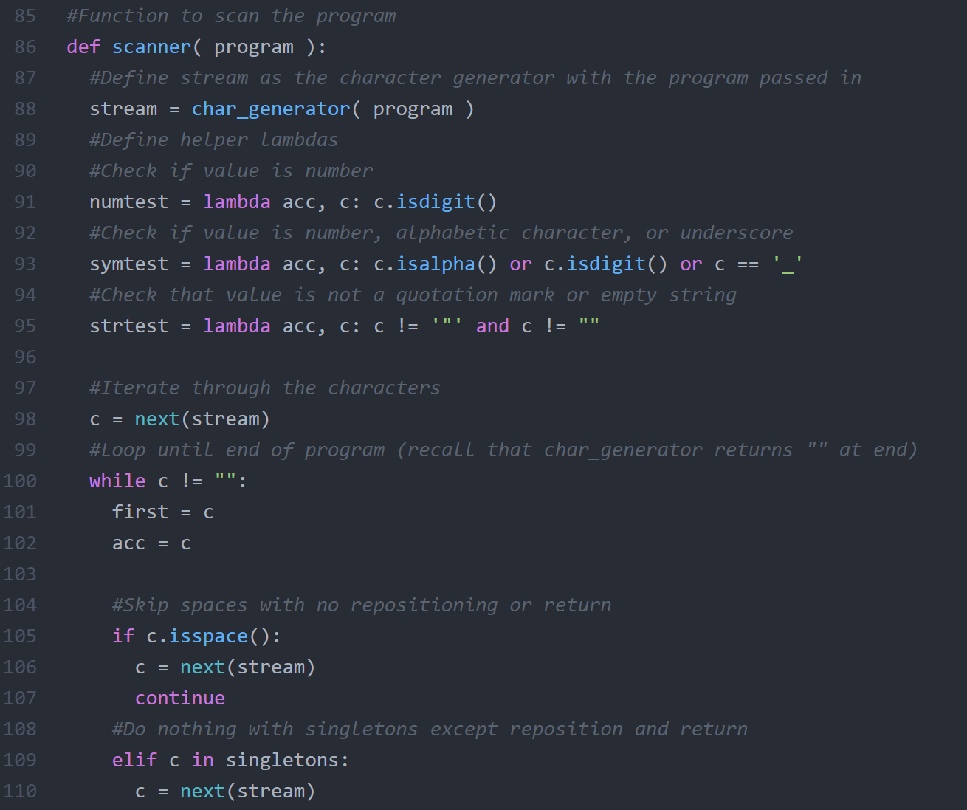
Python Scanner Example
This generator yields tokens rather than characters.
It uses the character generator, and defines a few lambda functions to serve as conditions for parsing tokens.
The characters of the program are iterated through.
Spaces are skipped.
Singletons are a single character, so they will be returned as a single character token and nothing else need be done.

Slide 13
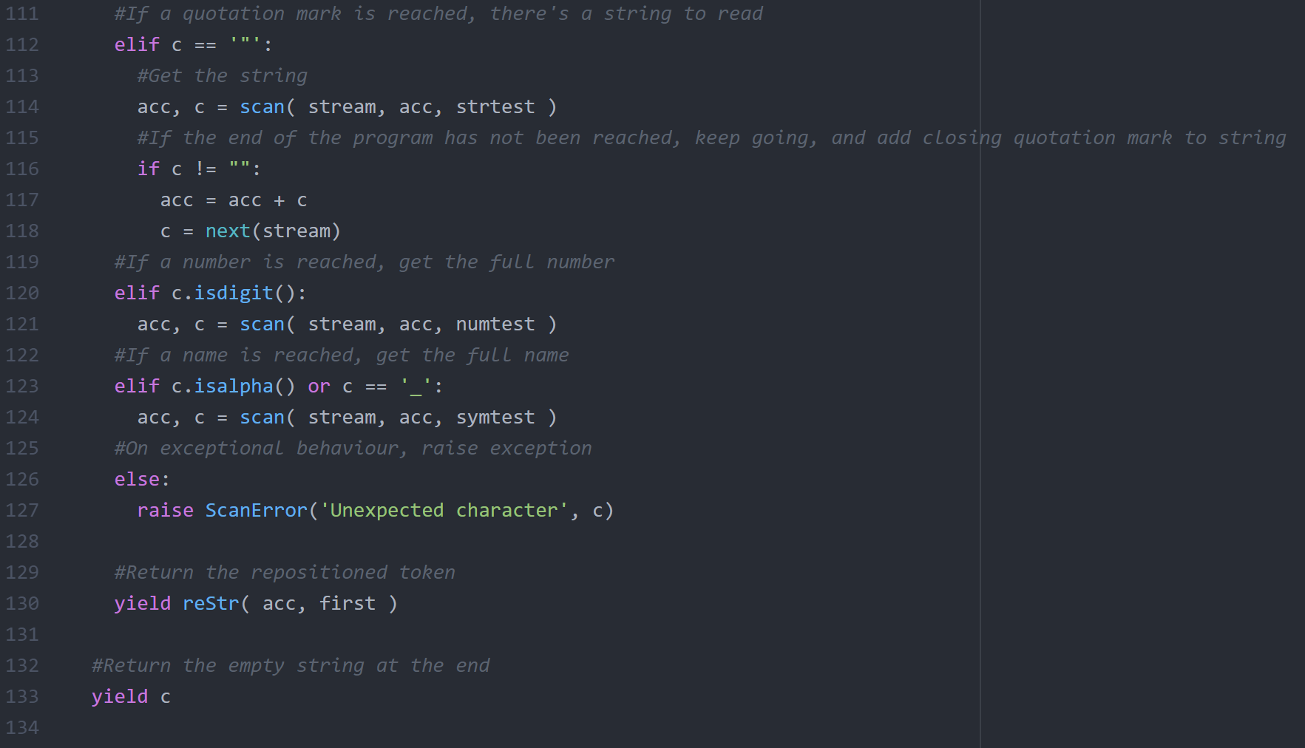
Python Scanner Example
A quotation mark signifies the start of a string token, so the string is built with the scan function, and this string token will be returned.
If the character is a digit, it may be the start of a longer number, so the number is built as the token to return.
If the character is alphabetic or an underscore it may be the beginning of a longer variable name, and will be built and returned.
If no conditions are met, an error is raised.
The token is returned, or an empty string after reading the whole program.

Slide 14
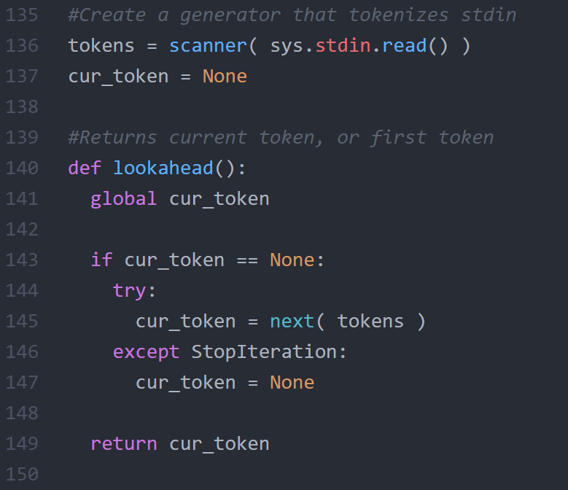
Python Scanner Example
The variable tokens stores a reference to the scanner generator, which will allow for iterating through the contents of stdin (command line input).
The lookahead function returns the current token if it’s not None, else it returns the first token, else it returns None if no tokens are left.
Note that global variables are used, and the function accesses the global variable, potentially modifies it, then returns it. You should avoid writing code like this and instead pass values to functions explicitly.

Slide 15
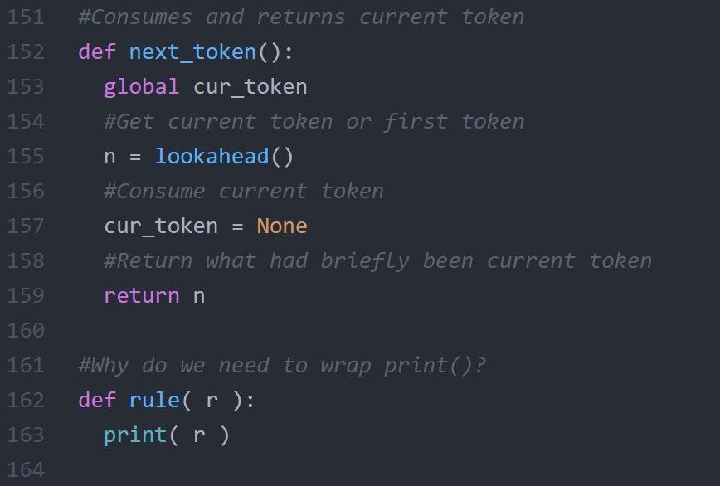
Python Scanner Example
This function returns the current or first token using the lookahead function.
It also sets the current token to None, effectively consuming that token and forcing lookahead to ask for the next token from the tokens generator next time it’s called.
The rule function is not used, nor does it seem to serve any purpose.

Slide 16
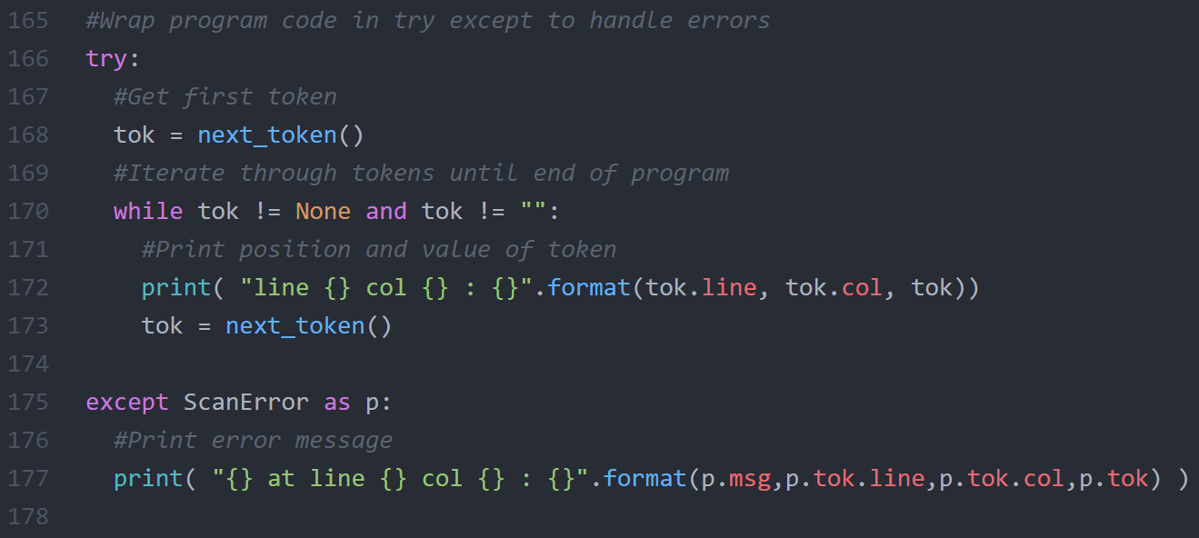
Python Scanner Example
The program logic block is wrapped in a try except statement so that exceptions are caught and printed if they occur.
Inside the try block, the tokens are iterated through and each token is printed along with its position in the program.

Slide 17
Good Practices
Complex data objects should be represented by classes.
Operations should be represented by functions.
Comments should be used to document major points of functionality, class and function interfaces, and anything else that’s non-obvious.
Variables, classes, and functions should be named descriptively.
Favour clear, readable, and straightforward code over concise, clever, or over-optimized code.
Code defensively – be wary of invalid input, edge cases, and other potential sources of error.

Slide 18
Developing the Program
Understand the problem. Write out the high-level view first.
Write pseudocode for what needs to be done.
Translate the pseudocode to real code. If a line of pseudocode takes more than a few lines of real code, write a function call. You can code up the function later.
Have each function serve a single purpose. If a function is doing multiple things, split it into multiple functions.
If you’re getting lost in low-level complexity, you may want to see if there are built-in functions that handle what you’re doing.

Slide 19
Testing the Program
For debugging purposes, consider producing additional tests for checking edge cases that may not be covered by the provided tests.
Ensure that the program runs on Bluenose, using the runme.sh script you provide. Do not assume that it will work on Bluenose if it works on your computer. Run it against all test cases on Bluenose to be sure.
After submitting to Brightspace, download your submission and run it on Bluenose to be 100% sure that you submitted a working version.

Slide 20
Done

